Slide 1

CMN260 Novel Ideas Week 11 Tutorial
Postcolonial Fiction

Slide 2

Critical Response
Postcolonialism....
...a body of writing that attempts to shift the dominant ways in which the relations between western and non-western people and their worlds are viewed.
Young (2003) Postcolonialism: A Very Short Introduction
What is postcolonial writing? Answer this question with reference to postcolonial narrative techniques used in Disgrace. Your answer must be supported with textual evidence from the reading, and it must include at least one academic reference.
Narrative techniques here could include technical aspects, eg. Coeztee’s use of Internal
Focalization of Awareness (that is, his construction of POV and tense) or his use
intertextuality and its function in the text.

Slide 3
Critical Response
Postcolonialism....
...a body of writing that attempts to shift the dominant ways in which the relations between western and non-western people and their worlds are viewed.
Young (2003) Postcolonialism: A Very Short Introduction
Considering Disgrace is written from a privileged point of view, that is, the POV of a white, educated, middle-aged male living in post-apartheid South Africa, how—when considering the quote above—does the text function as a postcolonial novel? What narrative devices does Coetzee use to ‘shift the dominant ways in which the relations between western and non-western people and their worlds are viewed’? Make sure to include textual evidence from the reading, and at least one academic reference.

Slide 4
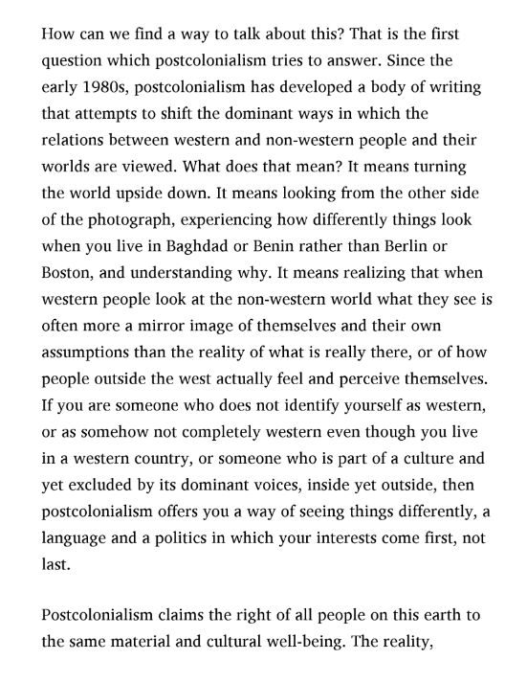
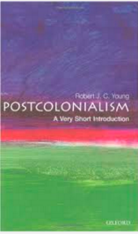
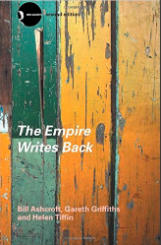
Critical Response
Postcolonialism: A Very Short Introduction
By Robert J. C. Young

Slide 5

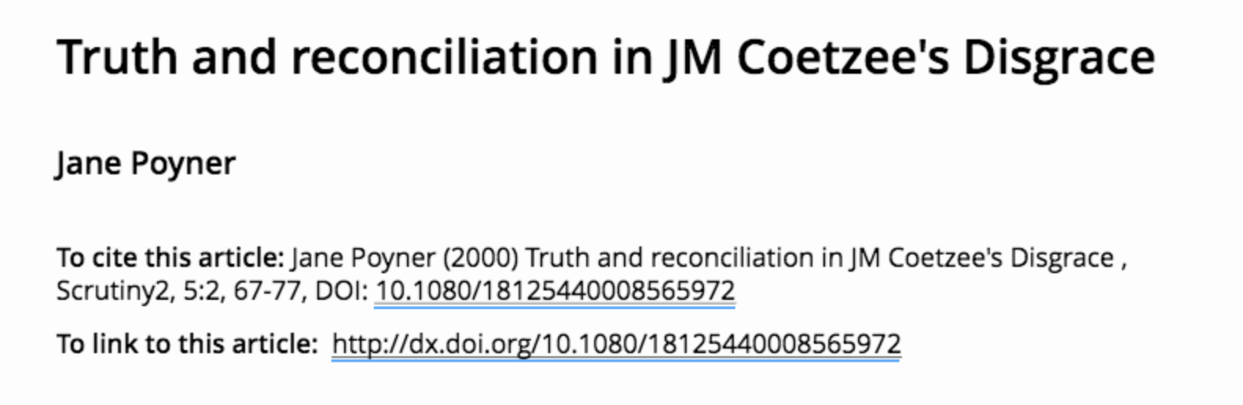
2. How does this statement, espoused by the character of Lurie, in Coetzee’s Disgrace function as metaphor for colonialism? In what ways is it problematic (when placed within the context of events in the novel)?
Your answer must be supported with textual evidence from the reading, and it must include at least one academic reference.
Critical Response
Suggested academic reference (for both critical responses):

Slide 6
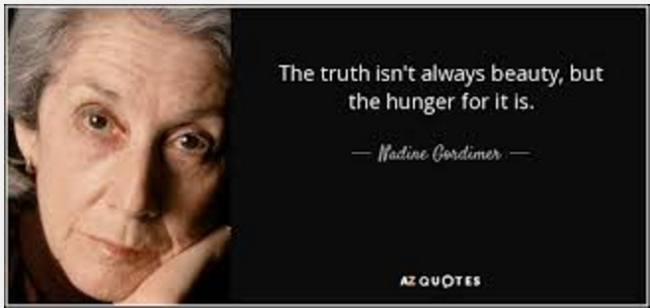


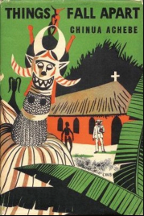
Creative Response
Nadine Gordimer said once that ‘Art is on the side of the oppressed’. Write a post-colonial piece in which you contextualise your scene in a post-colonial framework.

Slide 7
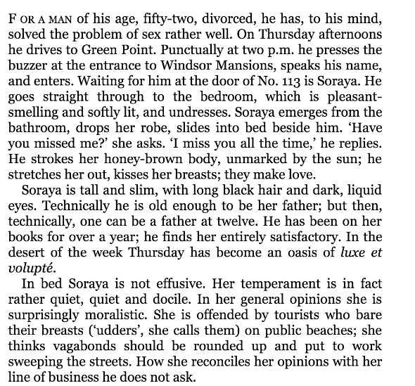
Creative Response
After closely examining Coetzee’s narrative voice/style in Disgrace, write a piece in close third person present with free indirect discourse (which does not use ‘thought’ verbs like ‘think’, ‘know’, ‘realise’).

Slide 8
Creative Response
After closely examining Coetzee’s narrative voice/style in Disgrace, write a piece in close third person present with free indirect discourse (which does not use ‘thought’ verbs like ‘think’, ‘know’, ‘realise’).
‘For a man his age, fifty-two, divorced, he has, to his mind, solved the problem of sex rather well.’
‘For a man his age, fifty-two, divorced, David Lurie has solved the problem of sex rather well.’
‘For a man my age, fifty-two, divorced, I have, to my mind, solved the problem of sex rather well.’
‘David Lurie, fifty-two, divorced, thinks he has solved the problem of sex rather well.’

Slide 9
Creative Response
In internal focalization (e.g., interior monologue or internal sensory perception), the present tense serves to establish a seemingly direct, unmediated link with a character's mind. In reports of actions, too, the present tense may have this effect of providing a link with a character's mind, in the sense that an action reported by the narrator in the present tense may be taken to be internally focalized by the character performing the action.
Expressing awareness on the character's part of the action being performed, this type of internal focalization is called Internal Focalization of Awareness (IFA). IFA is found in homodiegetic as well as heterodiegetic texts, whether they feature the present tense throughout or exhibit tense alternation. It is further argued that in all forms of internal focalization, including IFA, the present tense tends to be used in situations that are emotionally important to the focalizing character.
Homodiegetic narrator = a narrator who is also a character in the story
Heterodiegetic narrator = a narrator who is not a character in the story but in a way hovers above it and knows everything about it
(If the homodiegetic narrator is also the protagonist of the narrative, it is an autodiegetic narrator)
http://www2.anglistik.uni-freiburg.de/intranet/englishbasics/NarrativeSituation01.htm

Slide 10


Creative Response
Consider how tense changes the internal focalization (the character’s own awareness of the actions being performed)...
He continues to teach because it provides him with a livelihood; also because it teaches him humility, brings it home to him who he is in the world. The irony does not escape him: that the one who comes to teach learns the keenest of lessons, while those who come to learn learn nothing. (p.)
He continued to teach because it provided him with a livelihood; also because it taught him humility, brought it home to him who he was in the world. The irony did not escape him: that the one who came to teach learned the keenest of lessons, while those who came to learn learned nothing.

Slide 11
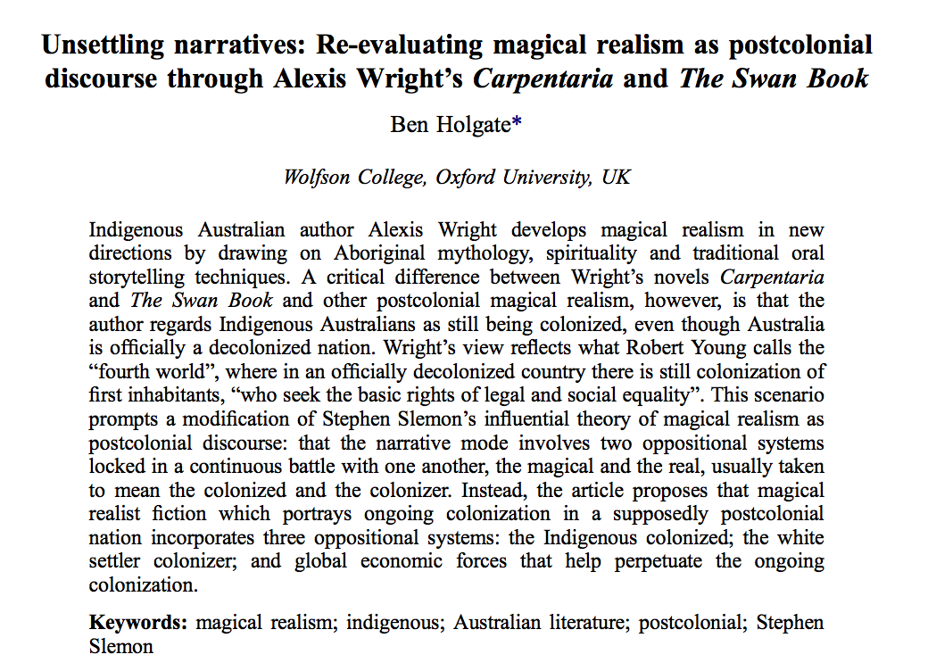



Something extra...

